Slide 1

Comprehensive Analysis of Pizza Sales 🍕

Slide 2


Introduction:
In the highly competitive food industry, understanding sales patterns and customer preferences is essential for optimizing business strategies.
This Pizza Sales Performance Analysis aims to provide valuable insights into the sales performance of different pizza types, sizes, and categories. This project focuses on analyzing key metrics such as total orders, revenue generation, and the most popular pizza types. By leveraging data analytics, the goal is to help pizza businesses make informed decisions, improve customer satisfaction, and increase profitability.
Description:
This analysis uses sales data from a pizza company to uncover trends and performance indicators. By addressing the following questions, this project will highlight the most relevant aspects of the pizza sales process and help the business enhance its offerings and operational efficiency:

Slide 3


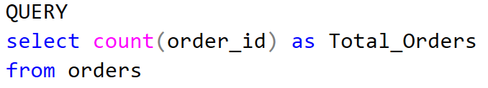
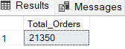
Find out the total number of Pizza 🍕 orders placed: Understanding how many orders have been placed is fundamental in measuring business activity and growth.

Slide 4

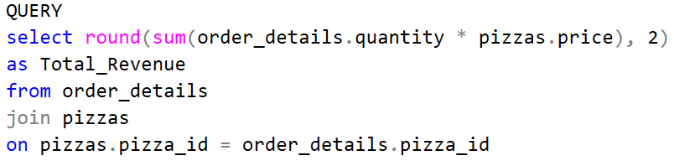
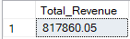
Calculate the Total Revenue generated from 🍕 Pizza Sales: Determining the total revenue will reveal the financial success of the pizza sales and help gauge the overall business performance.

Slide 5

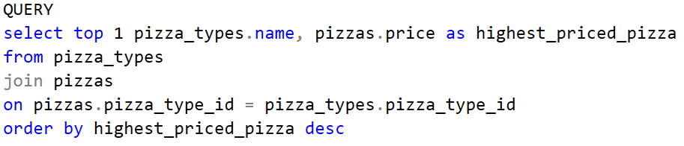
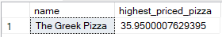
Calculate the highest-priced pizza🍕: Knowing the highest-priced pizza helps in analyzing the pricing strategy and its impact on sales.

Slide 6

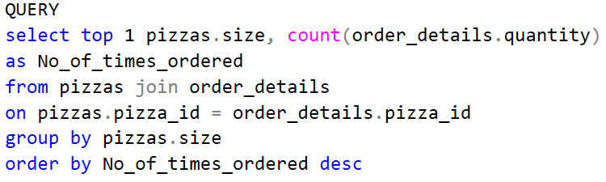
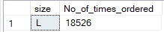
Identify the most common 🍕 pizza size ordered: By identifying the most popular pizza size, the business can adjust inventory and production to meet customer demand.

Slide 7

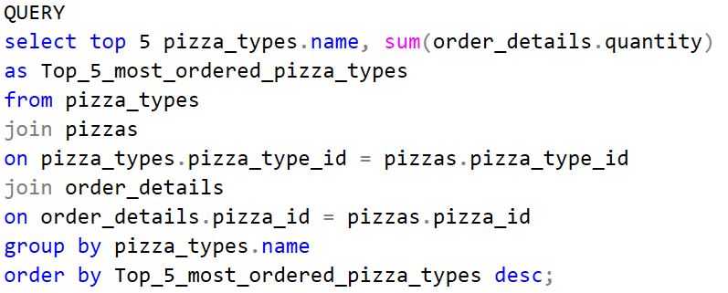
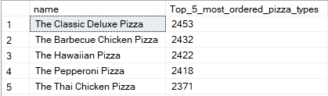
List out the top 5 most ordered 🍕pizza types along with their quantities: Highlighting the most popular pizza types provides insight into customer preferences, allowing for better menu optimization.

Slide 8

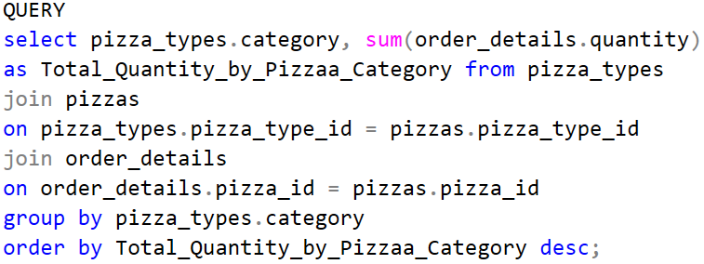
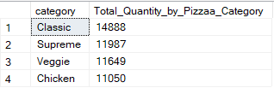
Find the total quantity of each pizza category ordered: Combining different data tables enables a deeper understanding of how different pizza categories are performing in terms of orders.

Slide 9

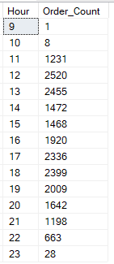
Calculate the distribution of orders by hour of the day: Analyzing order distribution by time helps in identifying peak business hours and optimizing staffing and supply chain logistics.

Slide 10

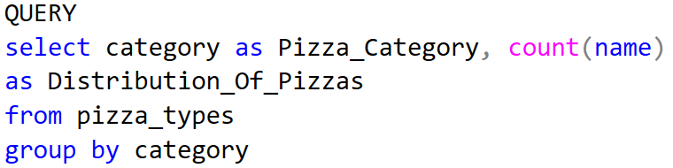
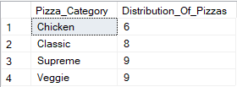
Find the category-wise distribution of 🍕pizzas: This step will further analyze the sales performance by category, offering insights into which categories are more popular.

Slide 11

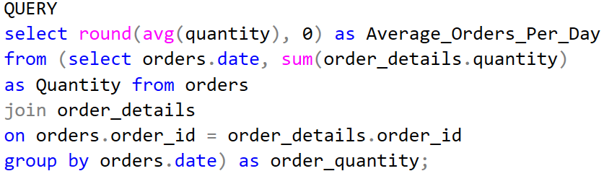
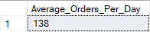
Find the orders by date and calculate average number of Pizzas ordered per day: Grouping orders by date and calculating averages allows for trend analysis and can help predict future demand.

Slide 12

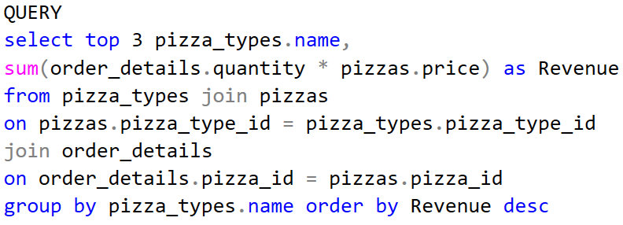
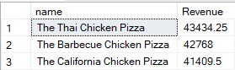
Determine the top 3 most ordered 🍕 Pizza types based on revenue: Identifying the top revenue-generating pizzas helps the business focus on promoting its best-performing products.

Slide 13
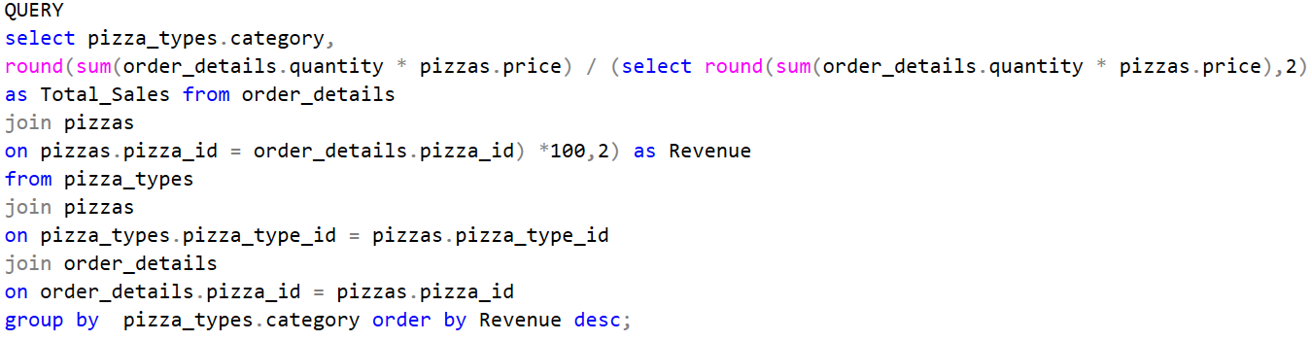
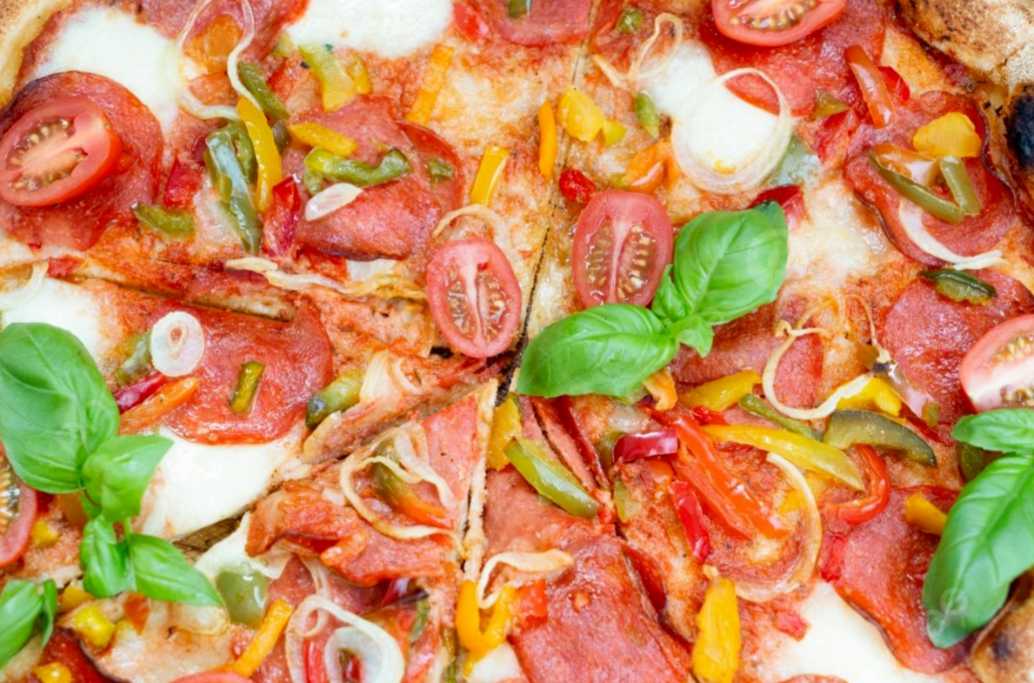
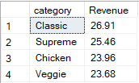
Evaluate the % contribution of each pizza type to total revenue: This analysis will show the significance of each pizza type in the overall revenue and help make decisions on promotions or menu changes.

Slide 14
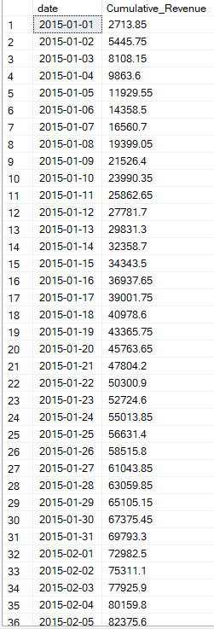
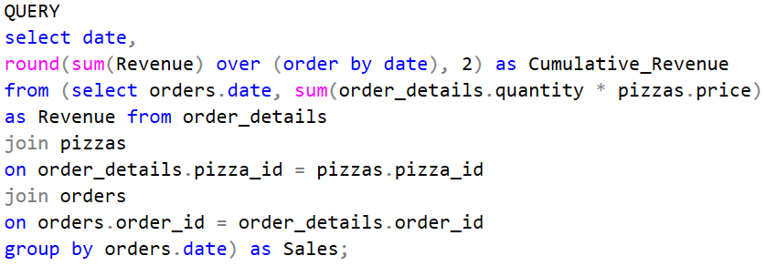

Analyze the cumulative Revenue generated over time: Cumulative revenue analysis provides a timeline view of financial performance, identifying trends or periods of growth and decline.

Slide 15

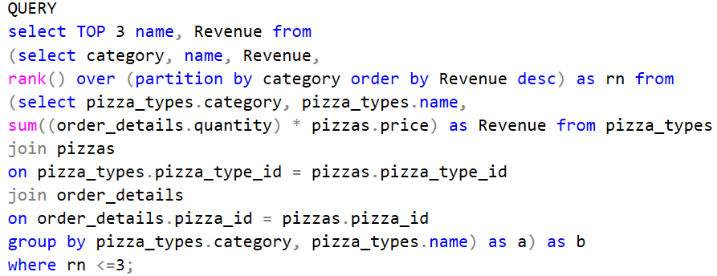
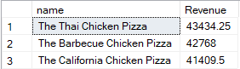
Determine the top 3 most ordered 🍕Pizza types based on revenue for each pizza category: Breaking down the most profitable pizzas by category gives a detailed view of which pizzas are driving success in each segment.

Slide 16


